Slide 1

5 Year Integrated M.Sc.(Computer Science) Semester - IV
Department of Computer Science Gujarat University
Bus Booking System
Presented By:
Maharshi Patel(88) Henil Pancholi(80) Harsh Parekh(81)
Dev Rabari(120)
Under the Guidance of :
Mr. Sidhhant Trivedi

Slide 2
Table of Content
Project Profile
System Analysis
Reference websites
List of users of the system
Use case diagram
Requirement specifications
Tools and Technologies
System Architecture
Module hierocracy
Work division
TimeLine Chart
System Design
ER diagram
Activity diagram for each module mentioned in the module hierocracy
Data Dictionary
Interface design and Screenshots

Slide 3
Project Profile
Profile | Description
Project Title | Bus Booking System
Aim of Project | To Provide customers with easy-to- utilize user experience for booking and purchasing tickets online.
Project Duration | 4 Months
Team Size | 4 members
Tools & Technologies used | XAMPP, PHP, BootStrap, JavaScript, CSS, MySQL.
Guide | Mr. Siddhant Trivedi.

Slide 4
Introduction
A mobile or web software solution designed to provide customer with a personalized easy-to-utilize user experience for booking and purchasing tickets online.
It stores customer’s personal data records, scheduled routes, frequent trips, drop points and other information.
It is more quicker and less time consuming.

Slide 5
System Analysis
Reference websites:-
GSRTC - https://www.gsrtc.in/site/
MakemyTrip- https://www.makemytrip.com/bus-tickets/
List of users of the system:-
Customers(passengers)
Admin
Requirement Specifications:-
Tools and Technologies:-
XAMPP, HTMl ,CSS, JavaScript, PHP, Database

Slide 6
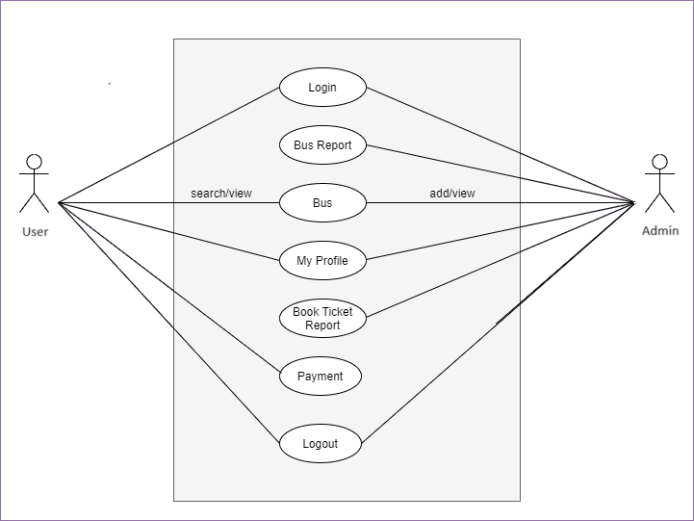
Use Case Diagram

Slide 7
System Architecture
Module Hierarchy:
Source
Destination
Date Selection
Seats Selection
Search
Time schedule
Choose Seats
Booking
Payment
Confirm Booking
Work Division:
Name | Work Division
Maharshi
Henil
Harsh
Dev

Slide 8
System Design

Slide 9
Data Dictionary

Slide 10
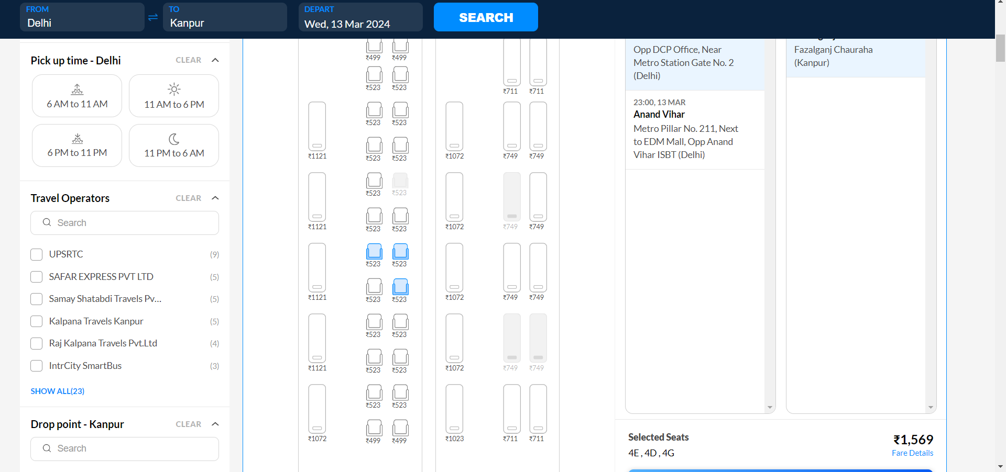
Interface design and Screenshots

Slide 11
Interface design and Screenshots

Slide 12
Thank You!!!

